Slide 1



Employee Retention
Group 3
Vidya Chenji
Sreerekha Rajendran
Grace Sigalla
Gowtham Vaddanam

Slide 2
Project Scope
WHAT - Our research and analysis are solely based on determining the main cause of employee turnover using IBM's data, and what can be done to promote employee retention
HOW - By doing data analysis and observing various factors such as age, education level, income and how they affect employee retention. With this EDA, we will be able to get actionable insights to better understand employees and make any necessary changes
WHY - Because employees are arguably the most important assets of a company, it is important to study and understand factors contributing to employee turnover in order to create better strategies to improve retention

Slide 3

Introduction
Employee attrition, often known as voluntary turnover, is a significant issue for businesses since it impacts not just productivity and work sustainability, but also long-term growth objectives.
When we consider the time, it takes to interview and locate a successor, placement fees, sign-on incentives, and the loss of production for many months, the cost of replacing a person may easily exceed a big amount. It's only logical that data science has begun to be used in this domain.
Understanding why and when workers are most likely to depart can help you take steps to enhance retention and plan for future hires.
People analytics or people data science are terms used to describe this type of data science application. People analytics helps companies, and their human resources (HR) professionals minimize attrition by transforming the way they recruit and retain talent in the age of data science and big data analytics.
Notes:
Employee attrition/turnover is one of the biggest challenges that most employers are facing.
https://www.bls.gov/news.release/pdf/jolts.pdf – The Bureau of Labor statistics, overall turnover rate in 2021 at 57.3% (including both voluntary which is at 25% and involuntary separations 29%) Turnover rate comes at a great cost as it leads to employers loosing well performing employees, decreased or stagnant performance and productivity, increase in burnout to the remaining employees who take on extra work and also comes with a huge dollar cost in terms of covering for the hiring process to fill those positions, sign on bonuses and covering for the loss of productivity.
Therefore, it is of outmost important for companies, their HR professionals to determine what are the factors contributing to this problem and produce better strategies to increase retention. And this is where Data Science applications come to play in order to provide efficient and timely solutions to help alleviate this problem.

Slide 4

Employee Retention: Example
CarMax Makes Hard Times Easier on Employees
The recession in 2008 led to tough times for companies and their employees across the globe. But instead of saving money for the company by cutting employee benefits, perks, and recognition programs, CarMax decided to go in the exact opposite direction.
During the 2008 recession, CarMax and its president and CEO Tom Folliard decided to invest more heavily in employee programs. CarMax boosted its employee training and development programs, helping existing employees earn raises and jump through the ranks of the company.
The company also focused on cultivating its own employee ideas via feedback to better their customer experience. Those ideas were then rewarded in strong employee recognition programs. In essence, the CarMax employee retention strategies became all about its employees.
In a statement during his speech at the Great Place to Work conference in 2012, Folliard said: “Take care of your associates, they will take care of our customers, and the rest will take care of itself.”

Slide 5


Use Cases
Insights into current and potential performance of individual employees.
Determine each employee's risk of leaving.
Comprehensive picture of each employee's contribution to the business
Score for each employee that indicates their risk of voluntarily leaving the organization
Data is used to create relevant insights and is tailored to its culture, salary plans, incentive programs, and other factors.
Holistic perspective of the organization
Notes:
Data Analysis done on this project will be used to provide insight on employee performance, determining factors causing turnover rate, provide a broad picture of each employee's contribution and in return be able to score their performances, ideas on employee incentives and development programs to improve retention and provide an overall perspective of the organization.

Slide 6

Exploratory DATA ANALYSIS: Why EDA?
Facts and Figures
Essential to predictive modelling, to know which employee is more likely to exit the firm by means of insights from various plots
To discover the hidden trends and patterns from data(between the features) via visualization.
Libraries used: matplotlib and seaborn(excluding data pre-processing)

Slide 7
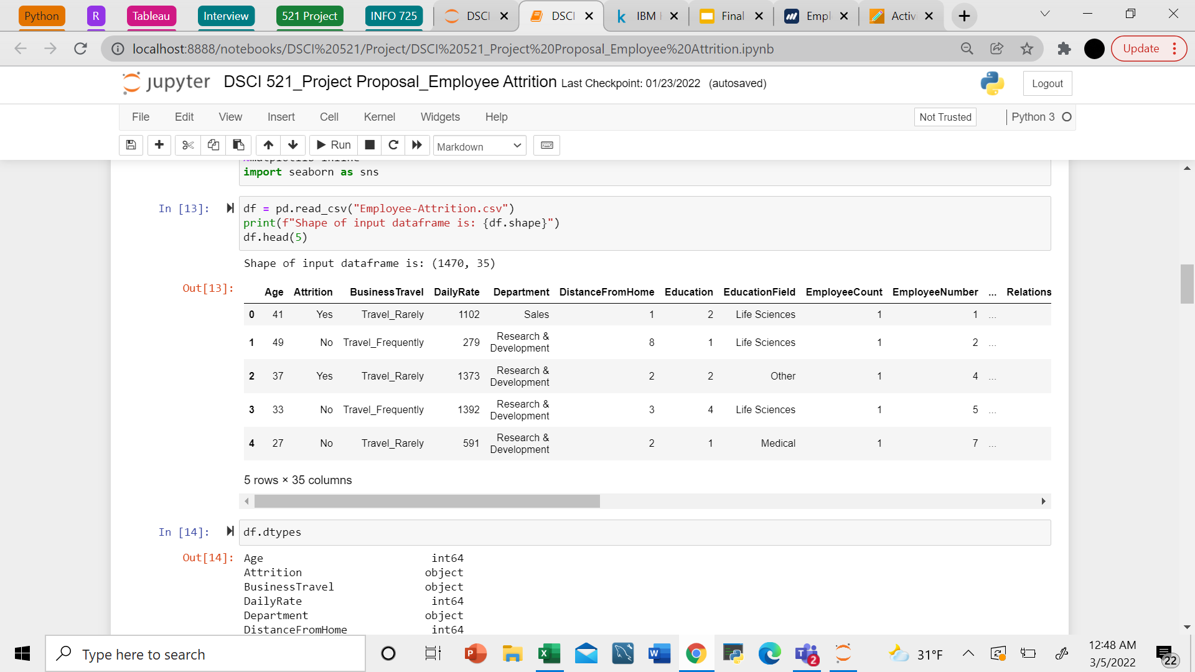
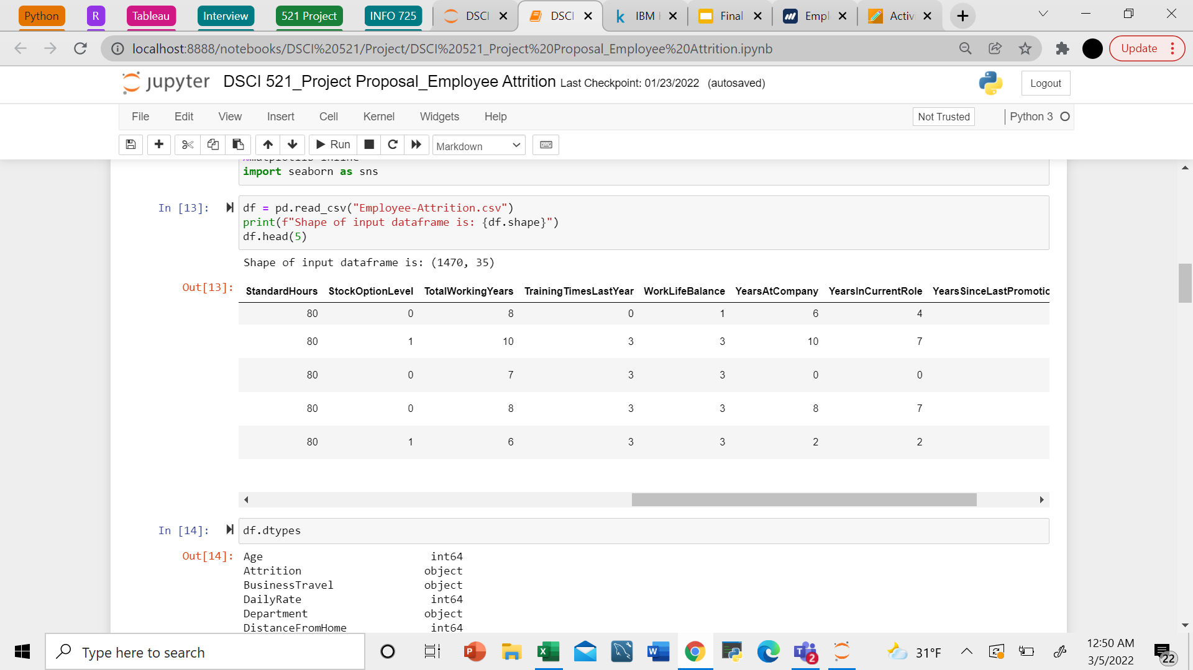
Sample Data
For our project, we are looking to use IBM’s pre-processed data on employee attrition and performance to conduct our analysis.

Slide 8
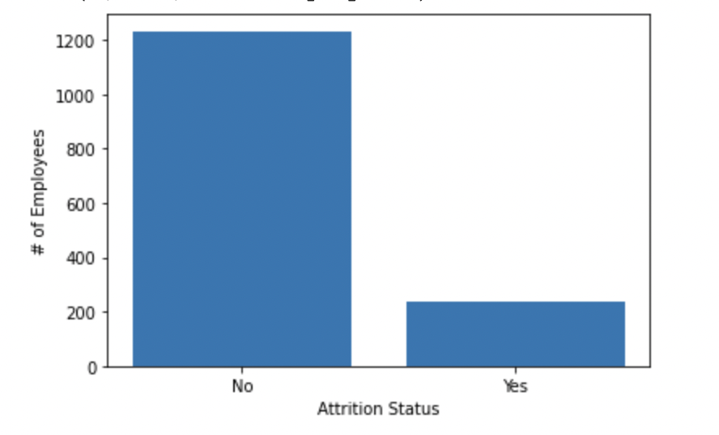
BAR PLOT SHOWING SIZE OF THE TWO CLASSES (NO ATTRITION VS. ATTRITION) IN THE DATASET

Slide 9
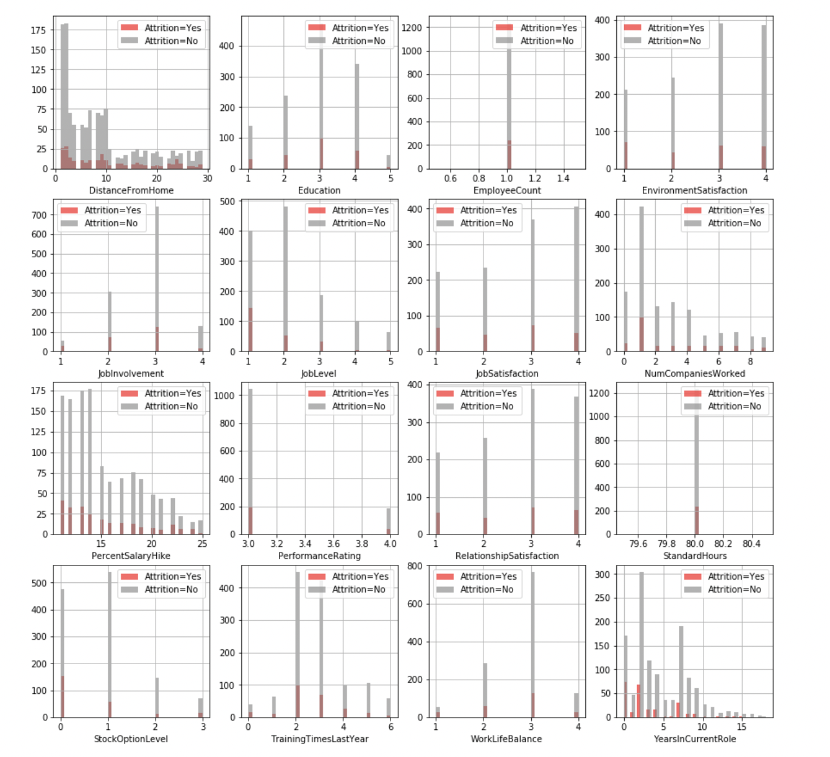
BAr plots with all numerical features

Slide 10
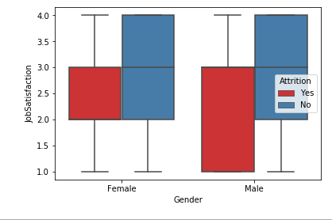
Box plot: Gender wise job satisfaction

Slide 11
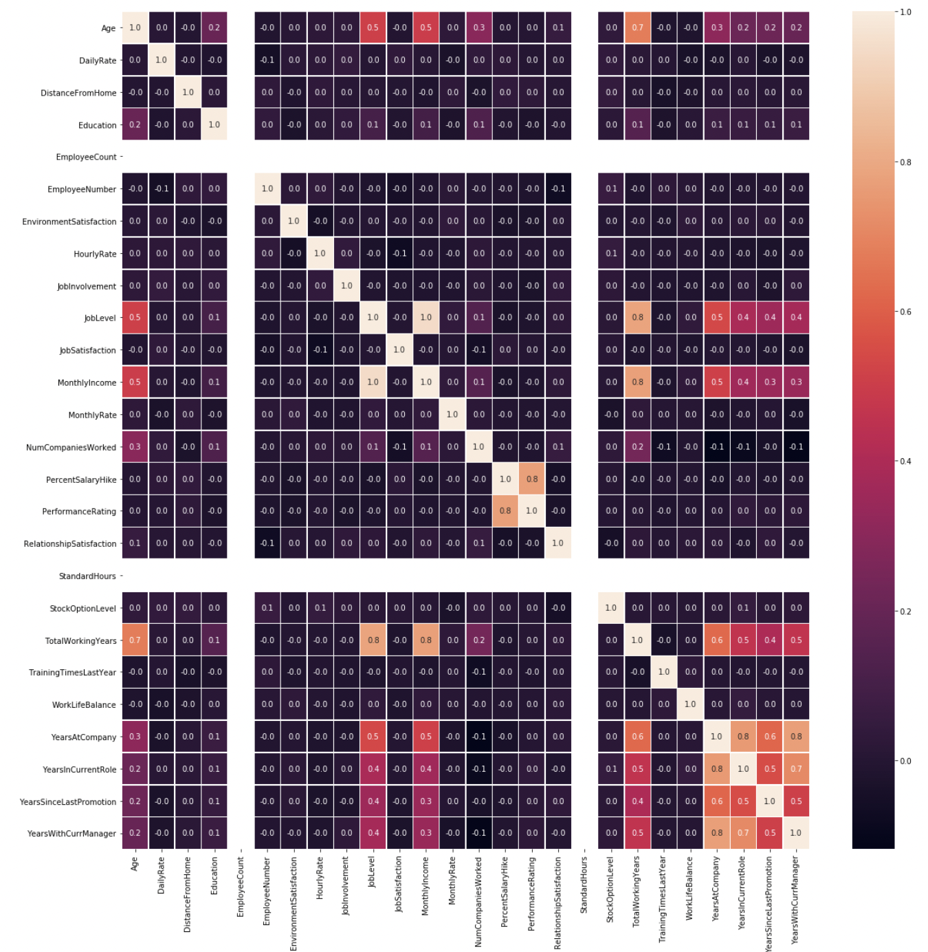
Heat MAp: Correlation(IVca)

Slide 12
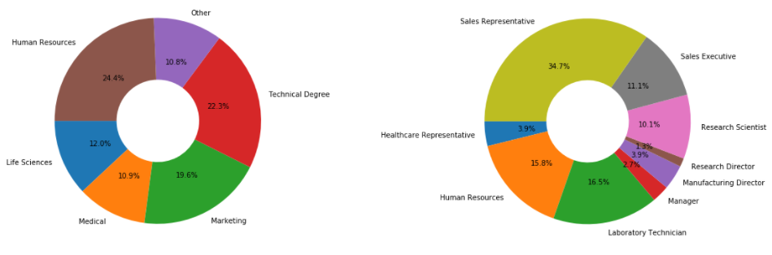
Doughnut chart: Department & Job role

Slide 13
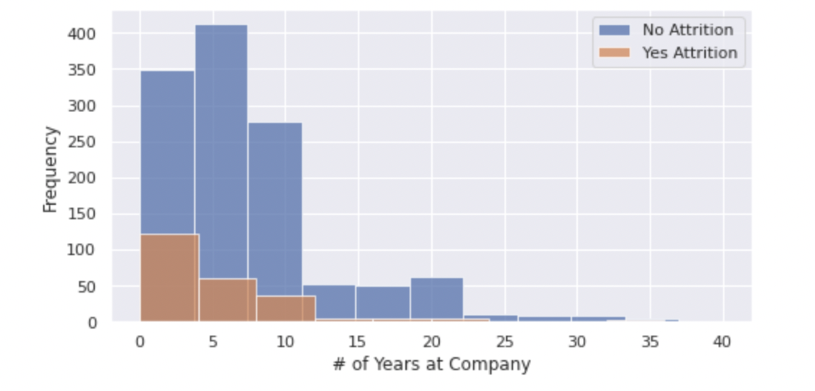
Histogram comparing distribution of Years At Company by Attrition Status(rvca)

Slide 14
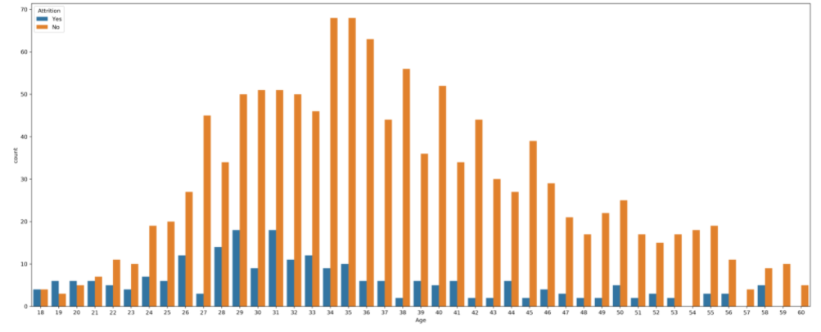
Count plot: Age by attrition status(rvca)

Slide 15
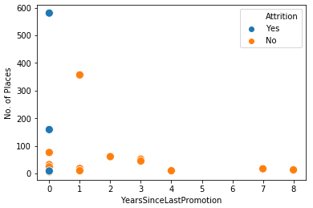
Scatter plot: Promotion Vs. Attrition

Slide 16
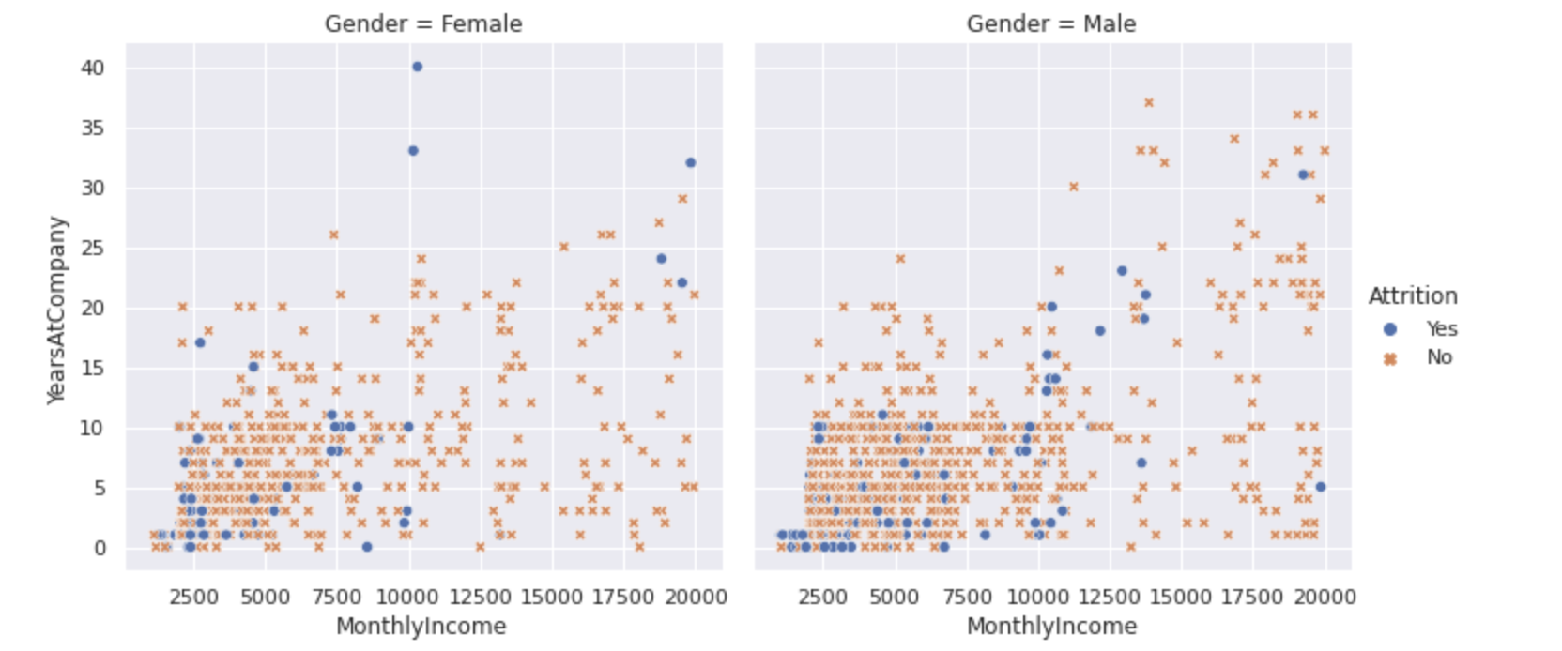
Scatter Plot of Monthly Income vs. Years At Company colored by Attrition and split by Gender

Slide 17
Takeaways from eda:
Environment satisfaction, Job satisfaction, relationship satisfaction features don't have much impact on Attrition Status.
Job level is directly proportional to Monthly Income, since both are highly correlated.
Sales Representative Job role has the highest attrition rate.
More employees tend to leave with less than 7 years of work experience.
Young professionals(below 21) are more likely to leave the firm.
Lack of promotion leads to leaving jobs.

Slide 18
MACHINE LEARNING MODELING
We used machine learning algorithms to train and test datasets to predict employee attrition based on input features.
We used a linear (Logistic Regression, LR) and non-linear (Random Forest, RF) machine learning model.
Additionally, with the limited size of the dataset, we used k-fold cross-validation to generate less biased models. We used a k=5 for our experiments.
The models were evaluated across several metrics like accuracy, F1-score, and Area under the ROC Curve (AUC) on the test set.

Slide 19
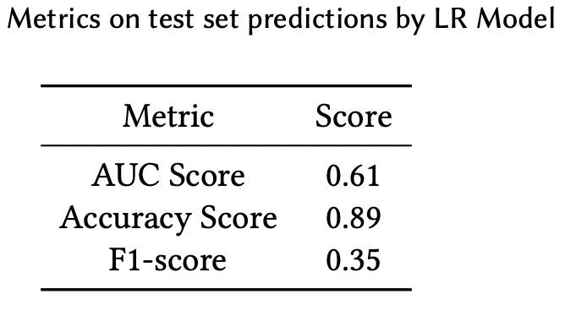
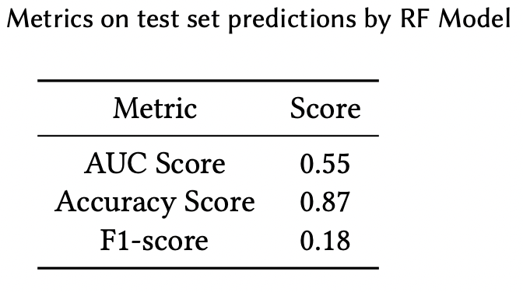
Metrics on test set predictions
0.86
When compared across multiple metrics like accuracy, F1 score, area under ROC curve, the RF model beat the LR model.
Notes:
When compared to the LR model, the RF model only showed a small improvement in the accuracy score. However, we know that accuracy is sensitive to class imbalance, hence we looked at other metrics like F1-score and AUC and saw that the RF model performed much better than the LR model.
Accuracy is the % we were able to classify correctly. However, it is very sensitive to class imbalance, hence we evaluated other metrics like F1-score which is the harmonic mean of precision & recall

Slide 20
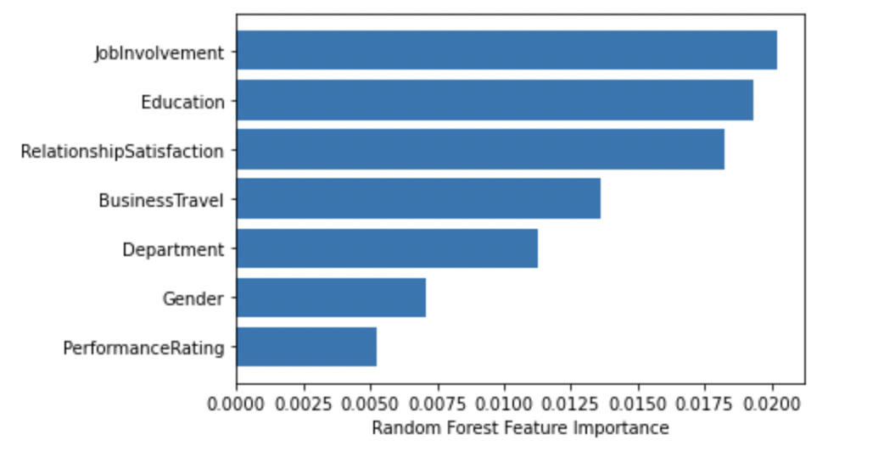
Feature Importance from RF Model
We also explored the feature importance score, which revealed that job involvement, education, and relationship satisfaction were the top three critical features that played a role in predicting attrition.

Slide 21
Limitations
Our data analysis is limited to only one specific company, IBM, using information we found on Kaggle. Our research and analysis are solely based on determining the main causes of employee turnover, and what can be done to promote employee retention.
Potential improvements include doing further analysis to determine better strategies to be taken in order to improve employee retention and in return, reduce turnover. Such as different means of incentives, and who and when is it best to reward an employee before it is too late. Also, an additional factor that one can do data analysis on is the effect of COVID-19 as a major cause of employee attrition.

Slide 22
Conclusions
The usage of data analytics in this area may help businesses target high-risk and high-performing individuals for retention initiatives, and it can even help them make evidence-based decisions about incentive payments, equity grant distributions and coming up with employee development programs that will aid in the professional growth of employees. In today's fast-changing and highly competitive world, this knowledge is vital in helping companies stay true to their goals, vision and mission.
We believe that this project will provide us with a substantial chance to improve our data analysis abilities. As mentioned above, when used to measure the risk of keeping an organization's most valuable personnel, data analytics may offer substantial advantages over traditional techniques. Hence, this project can help us strengthen the skills that we learn throughout this course.

Slide 23

Team Contributions
Gowtham – worked on exploratory data analysis
Vidya - worked on the predictive modelling
Grace – creation of the presentation and review of the data analysis and modelling
Sreerekha – creation of the presentation and review of data analysis and modelling
Overall, all group members had a part to play in every step that was taken in order to make this project a success.

Slide 24
Thank you

